Slide 1


Purpose Statement :
Unnati Problem Statement:
Introduction to Gen AI and Simple LLM Inference on CPU and finetuning of LLM Model to create a Custom Chatbot
In industries such as journalism, research, and content marketing, professionals often face the challenge of quickly extracting meaningful insights from numerous articles, reports, and PDFs. This process is not only time-consuming but also prone to human error and cognitive overload.

Slide 2

PDF Analyzer

Slide 3
Table of contents
01
02
03
04
05
Technical Implementation
Introduction
Features
Demo
Conclusion

Slide 4

Why not ChatGPT? Why create another tool?
1. Copy Pasting Articles is a tedious task in GPT.
2. We need an aggregate knowledge base.
3. ChatGPT word limit.

Slide 5


01
Introduction

Slide 6
INTRODUCTION
PDF Analyzer is designed to:
Streamline the process of retrieving and processing multiple PDFs.
Provide insightful and comprehensive analysis using advanced techniques.
This tool showcases the integration of cutting-edge technologies such as Streamlit for the user interface, Langchain and Gemini for NLP, and FAISS for efficient vector storage.

Slide 7

Features
O2

Slide 8
Key Functionalities :
PDF input for analysis.
Text Splitting and Processing.
Embedding Vector Creation with FAISS.
Accurate result generation

Slide 9

O3 Technical Implementation

Slide 10
Technologies and Libraries Used :
Streamlit for Web Interface.
Langchain and OpenAI for NLP.
FAISS for Vector Store.
Application Flow :
Data Loading: Retrieve articles from URLs.
Text Splitting: Process and split text into manageable chunks.
Embedding: Create vector representations of text.
Query Processing: Answer user queries using the vector store.
Answer Generation: Generate and format the responses.

Slide 11
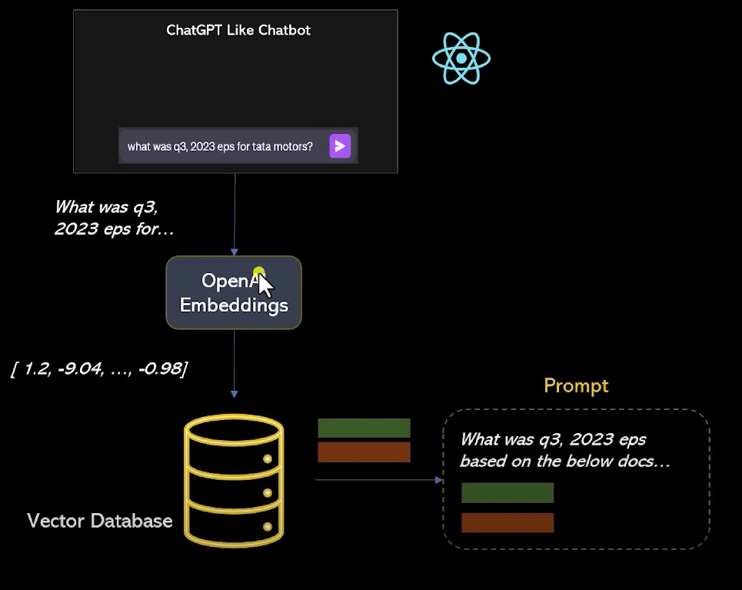
Chatbot :

Slide 12


O4 Demo

Slide 13
O5 Conclusion
Summary :
Developed a comprehensive tool for PDF analysis.
Utilized modern NLP and machine learning techniques.
Demonstrated practical application and benefits.
Learning Outcomes :
Gained experience in integrating various technologies.
Learned about the challenges and solutions in NLP and AI projects.

Slide 14
THANKS !
+91 78500 56007
https://www.linkedin.com/in/parth-garg-336695289/
parth.garg_cs.h23@gla.ac.in
Do you have any questions?

